Slide 1

Business Management for IT
(IT3090)
Managing People II
(Lesson 5)
站长素材 SC.CHINAZ.COM
Chalani Kuruppu
MLRHRM (Col.), PGD.LRHRM (Col.) BBA (Hons) (Sheff Hallam),

Slide 2

LEARNING OUTCOMES
At the end of the lecture, students should be able to;
Understand the basic concepts of Human Resource Management (HRM).
Define HRM.
Provide an overview of functions of HRM.
Understand the significance of human resource.

Slide 3


Training & Development

Slide 4
Training and Development
The formal process of changing employee behavior and motivation in the way that will enhance employee job performance and then organizational overall performance.
The HRM function that formally and systematically provides new learning to increase employees’ capabilities so as to increase their current job performances and future job performance as well.
Help to achieve employee goals and organizational goals.
T&D is an attempt to increase job performance of the employee at present or future compared with the past by increasing the needed job-related capabilities.
Will increase employees’ job-related abilities.
anupama.d@my.sliit.lk

Slide 5
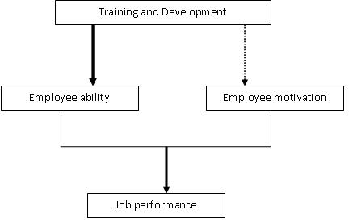
T&D helps to;
anupama.d@my.sliit.lk

Slide 6
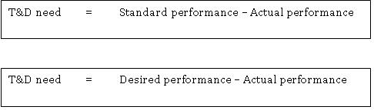
Why is T&D Necessary?
Employee performance deficiency is the degree of negative gap between the standard performance of the employee and actual performance
Need for T&D arises if performance deficiencies of the employees in the organization are due to lack of capabilities or abilities
anupama.d@my.sliit.lk

Slide 7
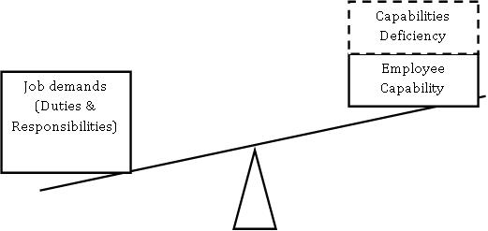
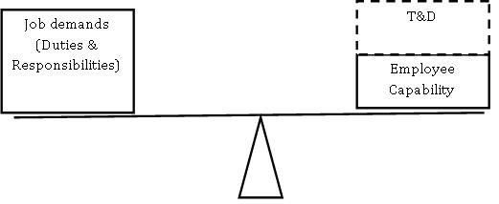
Why is T&D Necessary?
Before
After
anupama.d@my.sliit.lk

Slide 8

Methods of Training
On-the-job Training
Job rotation
Case study method
Understudy
Assignment
anupama.d@my.sliit.lk

Slide 9
Reward Management

Slide 10


Slide 11
Reward Management
The formulation and implementation of strategies and policies that aim to reward people fairly, equitably and consistently in accordance with their value to the organization.
It deals with the design, implementation and maintenance of reward practices that are geared to the improvement of organizational, team and individual performance.

Slide 12
Compensation
Pay is a statement of an employee’s worth by an employer.
Pay is a perception of worth by an employee.

Slide 13
Total Compensation
Direct
Indirect
Wages / Salaries
Time Not Worked
Vacations
Breaks
Holidays
Commissions
Insurance Plans
Medical
Dental
Life
Bonuses
Gainsharing
Security Plans
Pensions
Employee Services
Educational assistance
Recreational programs
Notes:
6

Slide 14
The Bases for Compensation
Hourly Work
Work paid on an hourly basis.
Piecework
Work paid according to the number of units produced.
Salary Workers
Employees whose compensation is computed on the basis of weekly, biweekly, or monthly pay periods.

Slide 15
Management of Incentives
An incentive is a special reward that drives an employee to perform beyond the normal level of performances.
It is an inducement that encourages the employee to perform in better way. Incentives are rewards designed to encourage and reimburse employees for efforts beyond normal performance expectations.
Incentives are paid in addition to wages and salaries and they depend on productivity, sales, profit or cost reduction efforts.

Slide 16
Management of Incentives
Financial Incentives | Non-Financial Incentives
also called as monitory incentives are considered are the most traditional and the most common form of incentives. Any incentive which is in the form of cash or wealth are based on the assumption that money is the most important motivating factor Ex: Target incentives Commission on sales Bonus Overtime payments Differentiated piece rate | are also called non monitory incentives relate to social and psychological needs of the employee Ex: Rewards and recognition Promotions Enhanced responsibilities and challenges Status and ranking Training Appreciation and praise Freedom for decision making

Slide 17
FRINGE BENEFITS

Slide 18
FEATURES OF FRINGE BENEFITS
An employee enjoys them in addition to the salary he/she receives.
They are not given for specific jobs performed but to make jobs more attractive.
They are not linked to productivity so do not reward performance in any way, criteria used is other than performance.
They have an indirect impact on workers’ efficiency. If impact is direct, it is not a fringe benefit.

Slide 19
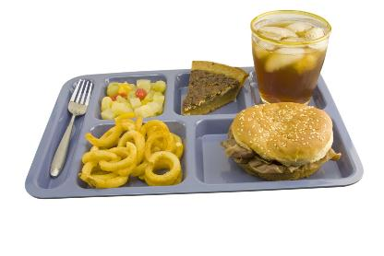
Types of Fringe Benefits
Wellness programs concentrate on keeping employees from becoming sick rather than simply paying expenses when they do become ill.
Child care programs assist parents with child care expenses.
Cafeteria-style benefits allow employees to choose the benefits they really want.

Slide 20
Grievance Handling

Slide 21
Grievance Handling
A grievance that is informal or formal, real or imaginary may be a severe source of conflict.
Hidden dissatisfaction grows and soon arouses an emotional state that may be completely out of proportion to the original complaint.
Frustration among employees can lead to a variety of counterproductive behaviors

Slide 22

Causes for Grievances
Causes relating to the working conditions
Causes relating to the Personal Management Decisions such as Policies, Procedures and Practices
Causes relating to Inappropriate Personal Behaviour

Slide 23


Methods of Handling Grievances
Open-door Policy
Committee Approach
Counseling

Slide 24
Principles for efficient and effective grievance handling
Treat all grievances as important
Obtain all relevant information
Discuss
Proper listening
Build Trust
Accept Mistakes

Slide 25
Labour Law

Slide 26
Labour Law
The employment relationship in Sri Lanka is based on the Employer-Employee relationship which over the years has gained protection under the law.
The Common Law concept of the contract based on a master and servant relationship under the Roman Dutch Law, which was later influenced by English Law concepts.
Basic labour Law

Slide 27
Key Objectives of Labour Law
Promoting Employer-Employee relations and maintaining industrial peace
Contributing national development
Preventing and settling industrial disputes
Regulating trade unions
Protection and welfare of women, children and young persons
Basic labour Law

Slide 28
Shop and Office Employee’s Act (No. 19 of 1954)
The regulations set out in these statues are the minimum conditions that employers should provide for their employees and the employers are free to grant better conditions at their discretion.
Shop: any premises in-which any retail or wholesale business is carried on including residential hotels, restaurants, hairdressing saloons, photo studios and laundries.
Office: any office maintained for business, clerical department of a factory, hotel, cinema and an office maintained in any other place including trade unions
Basic labour Law

Slide 29
Employees Provided Fund Act (No. 15 of 1958)
An act to establish a provident fund for the benefit of certain classes of employees and provide for matters connected therewith or incidental thereto.
It ensures the retiring benefits to employed persons by means of contributory provident fund.
Employee – 8% Employer -12%
Basic labour Law

Slide 30
Employees Trust Fund Act (No. 46 of 1980)
An act to provide for the establishment of a fund called the employees’ trust fund and to provide for matters connected therewith or incidental thereto.
No contribution from the employee.
The current rate is 3%
Basic labour Law

Slide 31
Some other related Acts;
Wages Board Ordinance (No. 27 of 1941)
Payment of Gratuity (No. 12 of 1983)
Budgetary Relief Allowances of workers Act
(No. 36 of 2005)
Medical Wants (Amendment) Act (No. 53 of 1993 )
Trade Union Ordinance, Chapter 174 (No. 14 of 1935)
Basic labour Law

Slide 32
Thank you
站长站素材 SC.chinaz.COM

